Slide 1
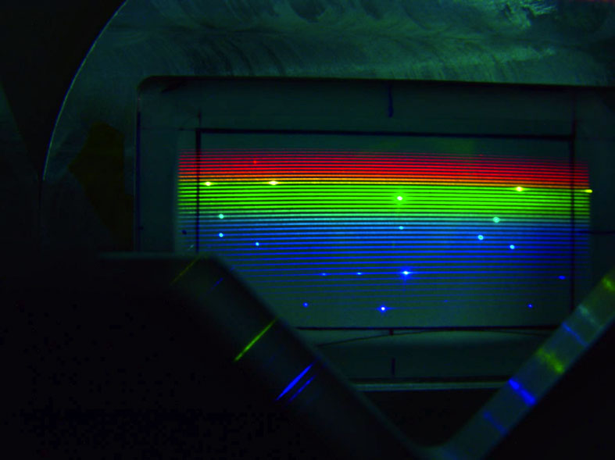
Spectroscopy

Slide 2
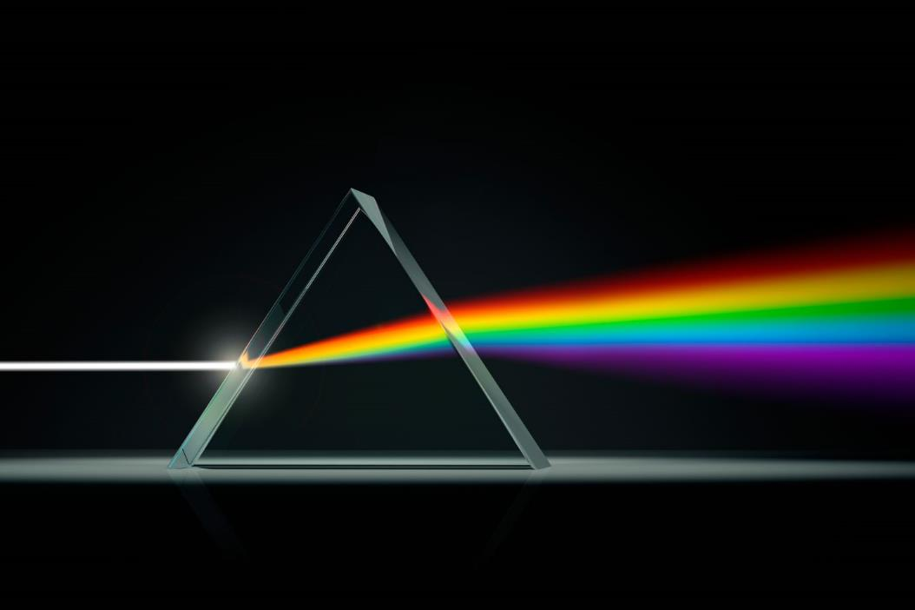
Which of the following is true about visible light
The entire electromagnetic spectrum is visible light
Only a small part of the electromagnetic spectrum is visible
Visible light has the shortest wavelengths
Visible light has the longest wavelengths

Slide 3
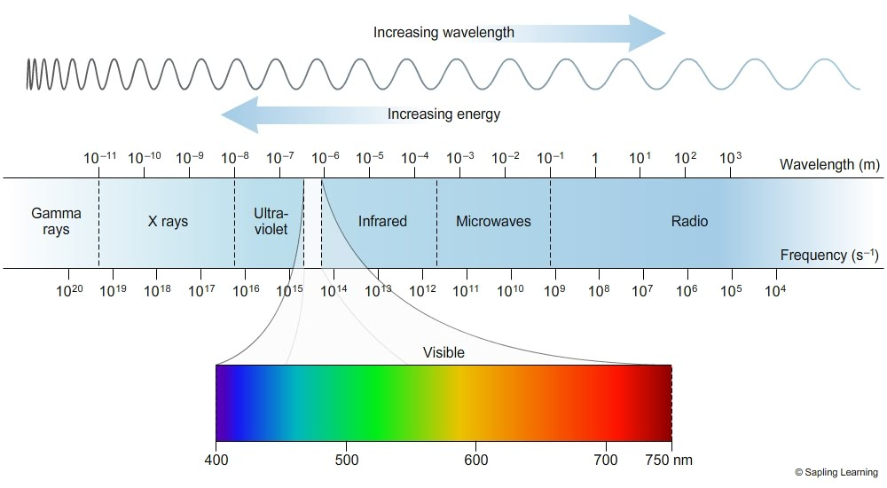
Which of the following is true about visible light
The entire electromagnetic spectrum is visible light
Only a small part of the electromagnetic spectrum is visible
Visible light has the shortest wavelengths
Visible light has the longest wavelengths

Slide 4
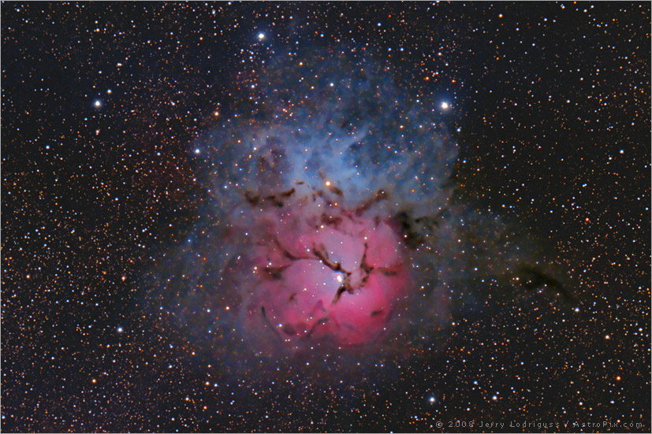
A spectrum of a black body, a heated gas cloud, and a black body viewed through a gas cloud are examples of

Slide 5
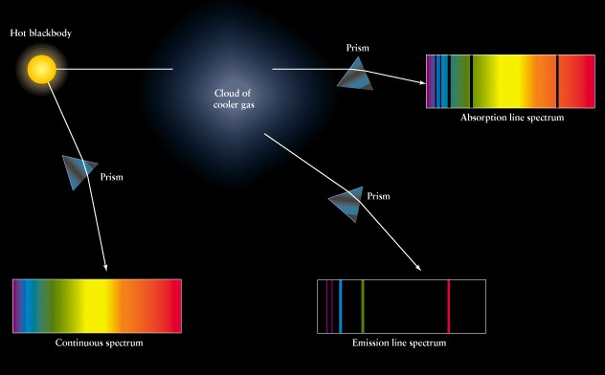
A spectrum of a black body, a heated gas cloud, and a black body viewed through a gas cloud are examples of
Continuous
Emission line
Absorption

Slide 6
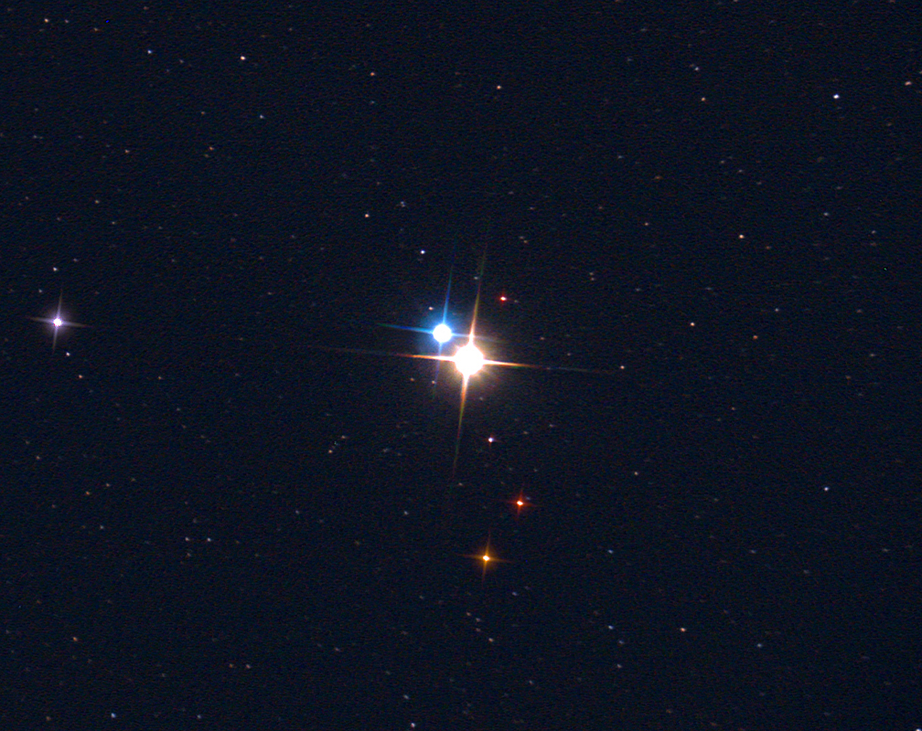
While observing the night sky you notice four stars: One red, one white, one blue, and one yellow. Which of these stars is hottest and which is coolest?

Slide 7
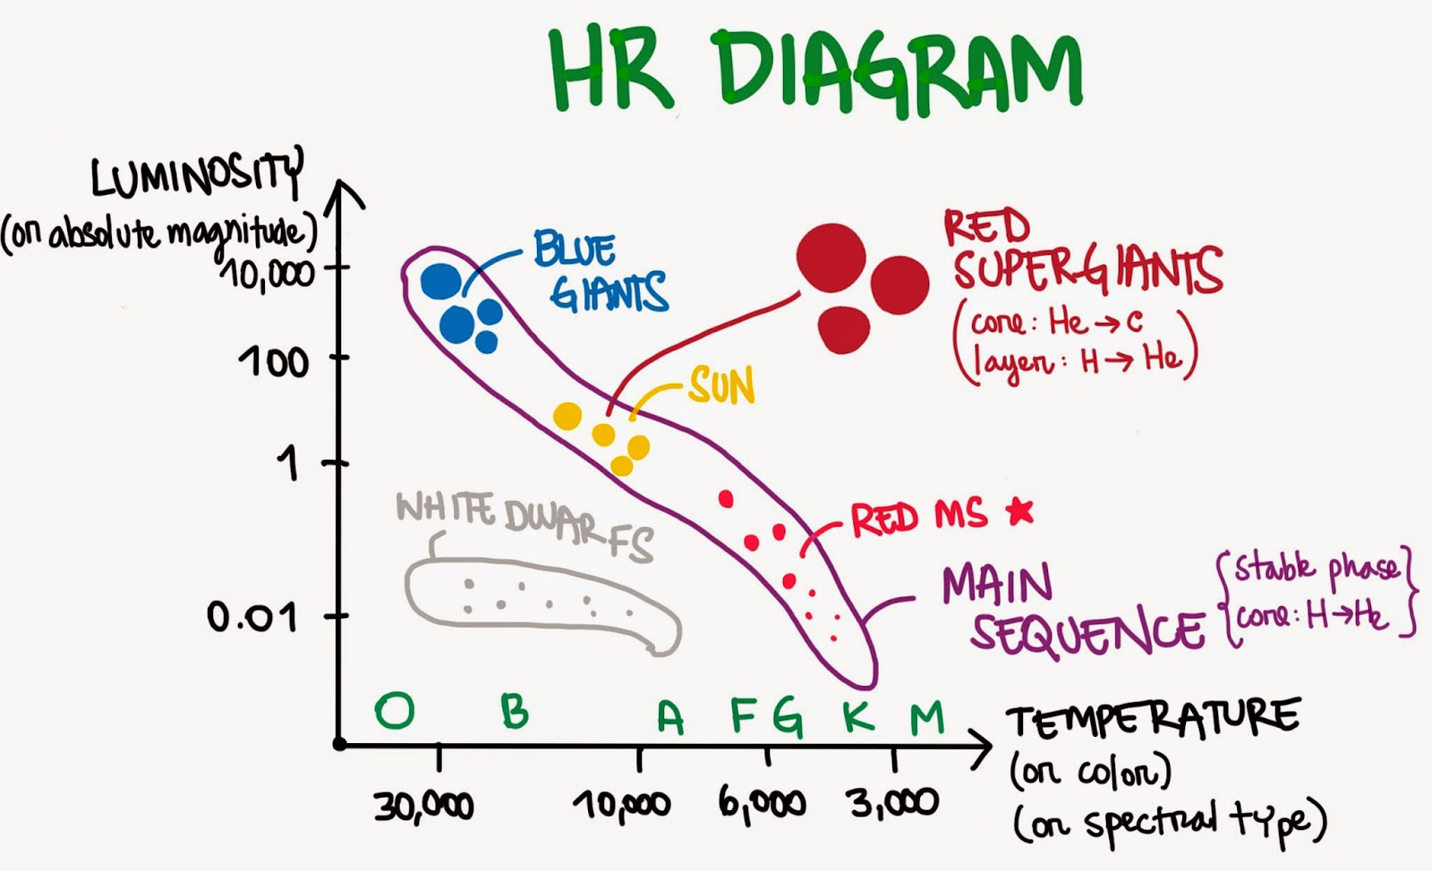

While observing the night sky you notice four stars: One red, one white, one blue, and one yellow. Which of these stars is hottest and which is coolest?
Blue Star = Hottest
Coolest = Red Star

Slide 8
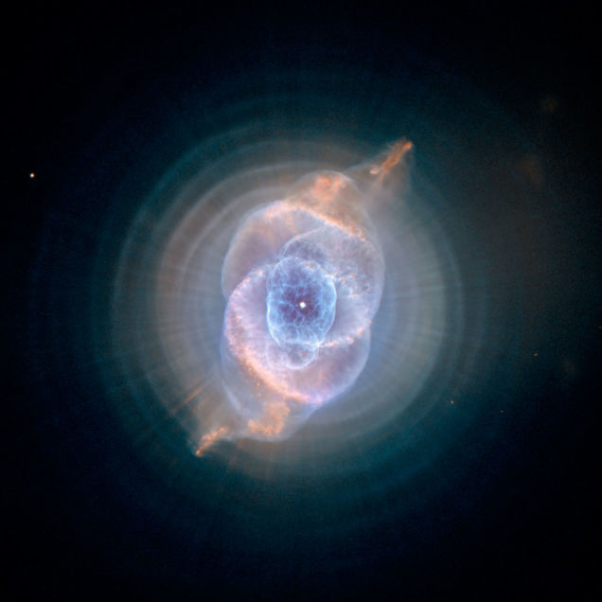
Which of the following properties of an object can potentially be determined by observing light emitted by it?
Chemical composition
Temperature
Relative motion
None of the above

Slide 9
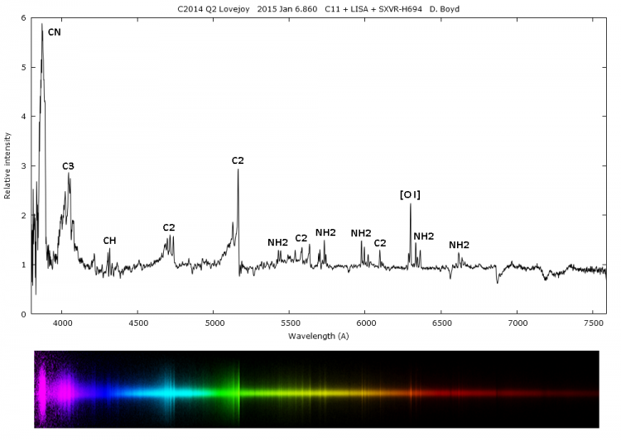
Which of the following properties of an object can potentially be determined by observing light emitted by it?
Chemical composition
Temperature
Relative motion
Chemical composition of comet Q2 Lovejoy

Slide 10
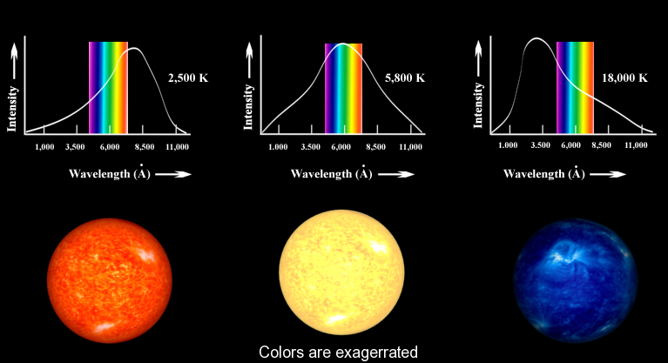
Which of the following properties of an object can potentially be determined by observing light emitted by it?
Chemical composition
Temperature
Relative motion
Estimating the temperature of a star from peak in spectrum

Slide 11
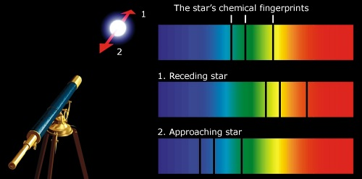
Which of the following properties of an object can potentially be determined by observing light emitted by it?
Chemical composition
Temperature
Relative motion
Relative motion from shift in emission lines (doppler effect)

Slide 12
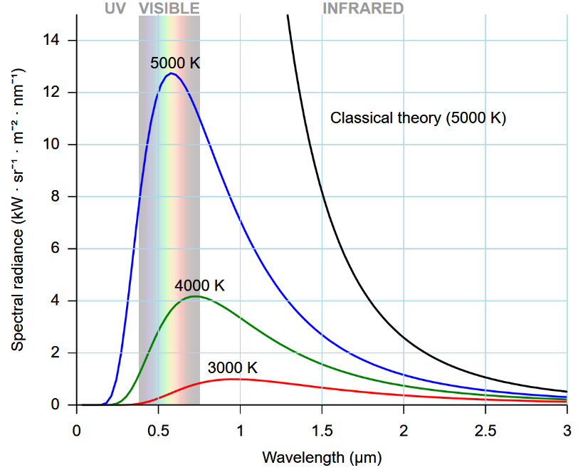
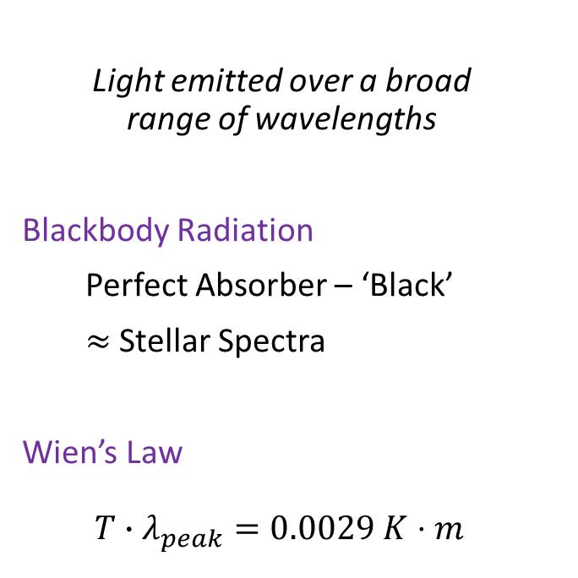
Continuous Spectrum
Light emitted over a broad range of wavelengths
Blackbody Radiation
Perfect Absorber – ‘Black’
$≈$ Stellar Spectra
Wien’s Law
$$T∙λ_{peak}=0.0029 K⋅m$$

Slide 13
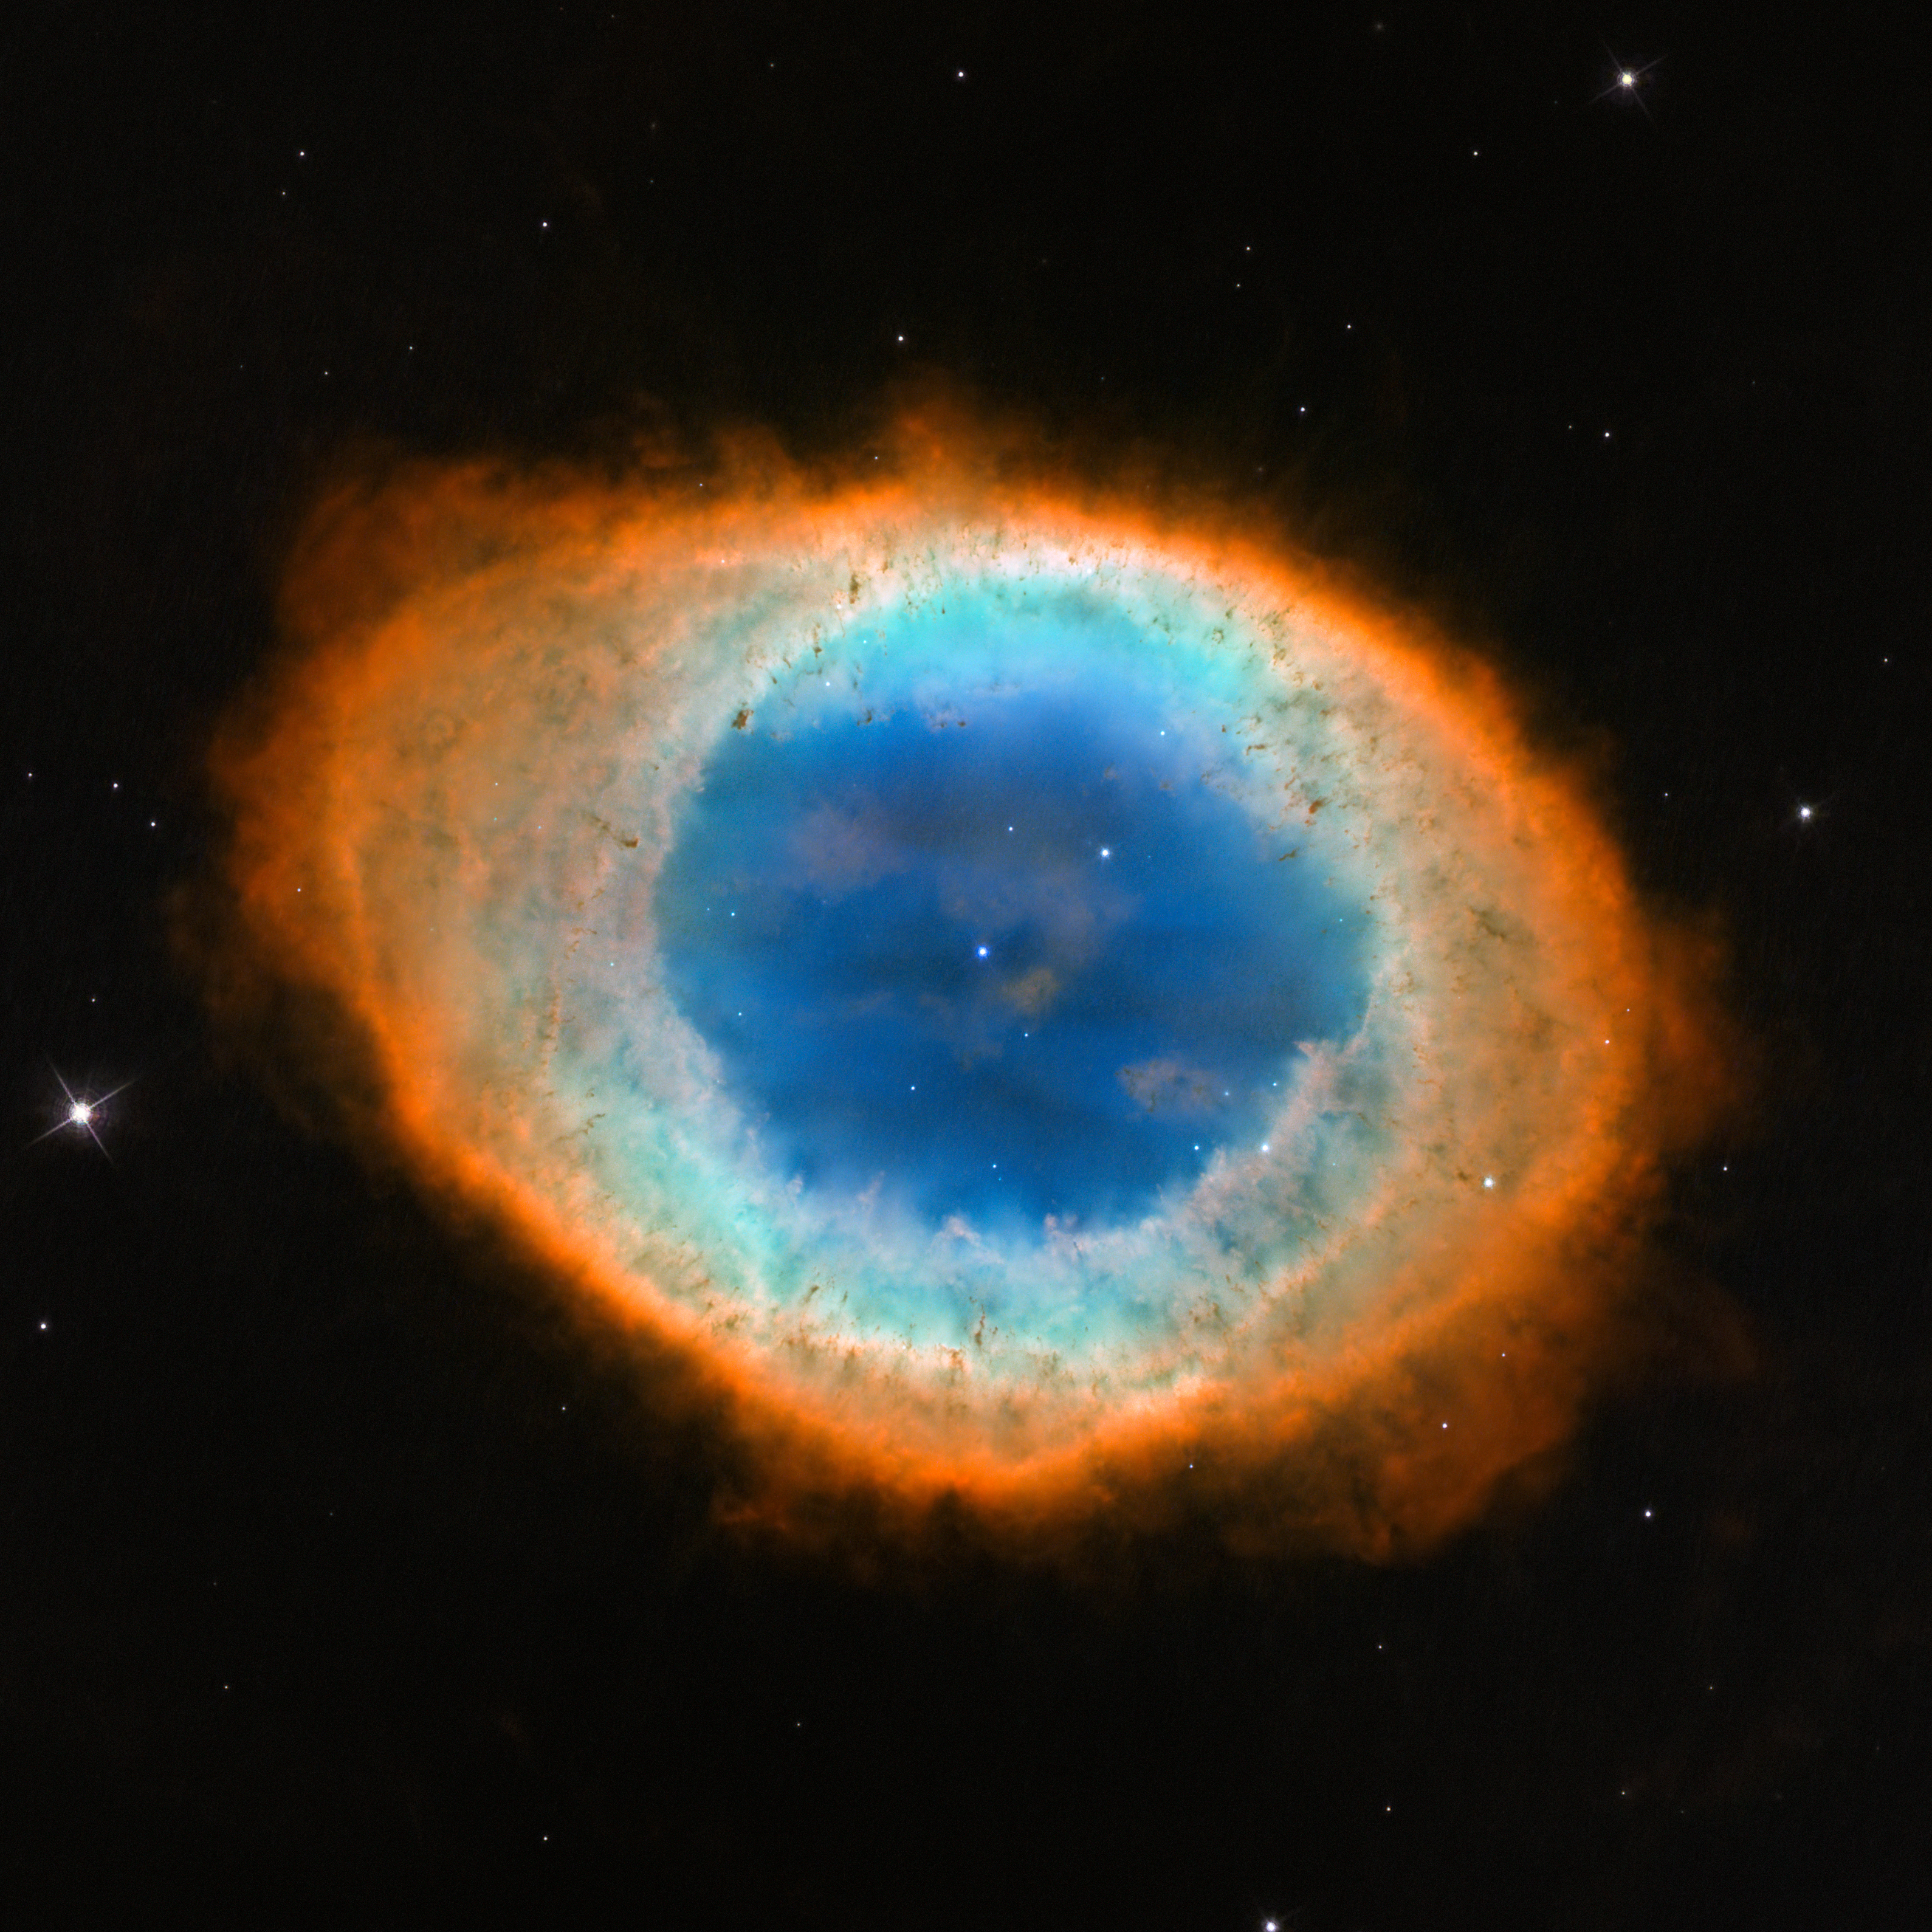
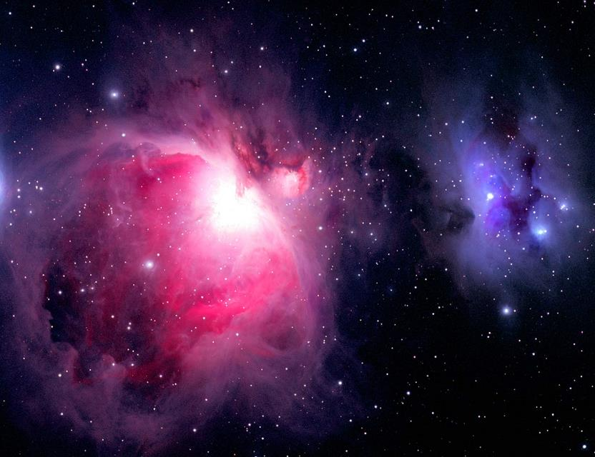
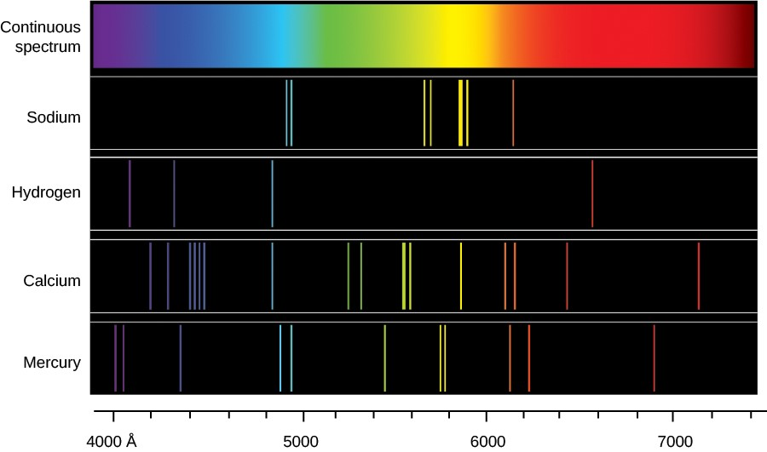
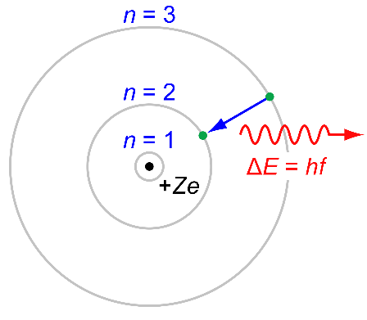
Emission Line Spectrum
Light emitted at discrete wavelengths
Electronic Transitions
Ionized Regions
HII Regions (Star-forming)
Planetary Nebulae

Slide 14
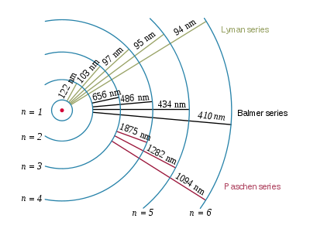
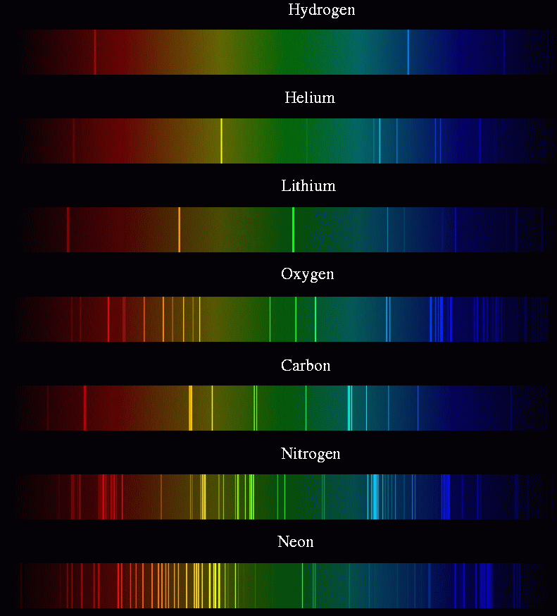

Slide 15
